Slide 1

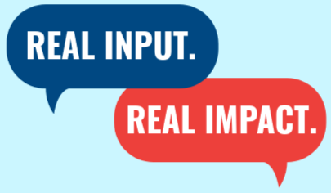
SCDD 2027- 2031
State Plan Development
Real Input. Real Impact.
Notes:
Welcome Everyone and thank you for joining us for this discussion of our 2027-2031 State Plan!
For those who don’t know me I am Aaron Carruthers and I am the Executive Director of the State Council on Developmental disabilities. I’ve been working in civil rights policy and programs for over twenty-five years, and this will be the third State Plan I’ve been part of developing in my time with this agency

Slide 2

Today’s Agenda
Learn
About SCDD and the State Plan
Understand
Why your feedback matters
See
How past input has made real change
Get
Get a tour of the State Plan Development Survey
Notes:
Here is a preview of what we’ll be going over today:
First – I’ll share a brief refresher of who SCDD is and our State Plan
Next – I’ll help you understand why your input is so critical to helping us build our State Plan
Then – Show you how we’ve put your input into action as an agency in years past
Finally – We’ll give you a brief tour of the Development Survey so you know how to take it and share it!

Slide 3

Who We Are

Slide 4
Who We Are
The California State Council on Developmental Disabilities (SCDD) is an independent state agency, established in both federal and state law. We are led by people with intellectual and/or developmental disabilities (I/DD) and their families, ensuring that lived experience drives our decisions.
SCDD is a disruptor of systems. Our work focuses on changing and improving policies, programs, and practices to make them more effective, efficient, and accountable for Californians with I/DD and their families.
Notes:
For those who are unfamiliar with SCDD … Read the slide

Slide 5
Our Work

Slide 6



How We Disrupt: Build Capacity
The Council strengthens the IDD community by providing them with information, training, and resources on:
Civil and Service Rights
Systems of Support
Emerging Areas of Concern
Notes:
SCDD’s work covers several key areas, SCDD Strengthens the broader I/DD community by providing information, resources, and training for families, professionals, service providers, and partners on civil and service rights, systems of professionals, service providers, and partners

Slide 7
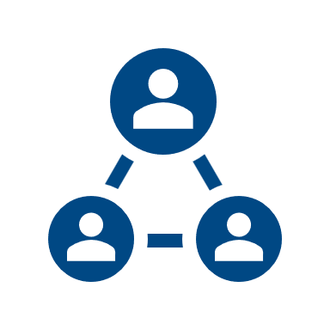


How We Disrupt: Promote Self-Advocacy
The Council invests in people with I/DD and their families to become leaders and advocates in their own lives and communities by providing:
Leadership Opportunities
Peer & Family Mentorship
Self-Advocacy Tools
Notes:
Next
By Promoting Self-Advocacy and Independence
We invests in people with I/DD and their families to become leaders and advocates in their own lives and communities. This includes hosting training programs like our Self-Advocacy Leadership Academy, family mentorship, peer-to-peer leadership opportunities, and tools that empower individuals to exercise independence and self-determination.

Slide 8
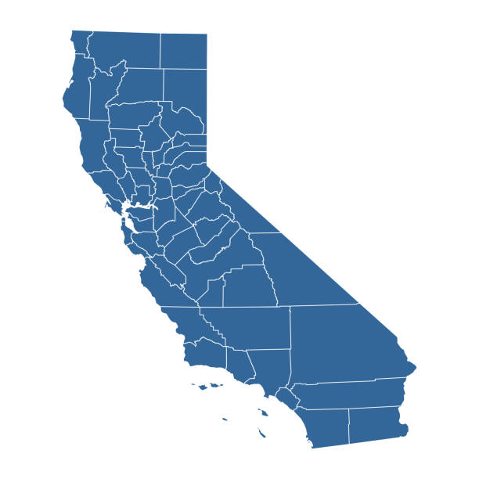

How We Disrupt: Change Systems
The Council disrupts and reshapes policies and systems so that they work better for people with I/DD through:
Legislative Advocacy
Statewide System
Improvement Projects
Notes:
The last key area of our work is Systems Change
We track how systems serve families and people with I/DD, and when we see gaps, we advocate for changes at both the state and community level. This includes sponsoring new laws and leading projects that address big, statewide issues in service systems.

Slide 9
The State Plan
Notes:
Now that we've talked a bit about our work, lets talk about our State Plan

Slide 10

The State Plan
  A new State Plan is developed every 5 years.
  It is guided by community input and is divided into our three goal areas:
  Self-Advocacy
  Systems Change
  Capacity-Building
Notes:
Every five years, SCDD develops a State Plan to guide our priorities and actions.
This plan is informed by community input and focuses on three overarching goals:
strengthening self-advocacy,
driving systems change,
and building capacity across the state.

Slide 11
Why Your Input Matters

Slide 12
Community Input Leads to Impact
Community Shares Input
Council Takes Action
Actions Lead to Outcomes
Impact Felt by Community
Notes:
For our State Plan to truly reflect the needs of Californians with intellectual and developmental disabilities, we need to hear from all of our communities. That means hearing from self-advocates, family advocates, and professionals—every perspective helps make the plan more accurate and inclusive.
This is why we have created a State Plan Development Survey. Through the survey the community provides its Input and that allows us to create a framework for the Council to take action. The action leads to outcomes and then real impact is felt by our communities

Slide 13
How Your Input Became Action
Notes:
Let's talk through some examples of this using the results of last survey in 2020

Slide 14

Input Action: Employment
2020 Community Input:
Employment was the #1 issue for Self Advocates
  #5 for Family Advocates
Shared desire for Competitive Integrated Employment
Notes:
When we asked self-advocates about their top priorities din 2020 we received thousands of responses and the number one issue we heard was employment—specifically the need for competitive, integrated employment.
Families echoed this concern, and highlighted the barriers in the system that make it harder for people with I/DD to find and keep quality jobs. This input made it clear that employment was not just one issue among many—it was the top priority identified by the community.
SSAN = Statewide Self-Advocacy Network
NDEAM = National Disability Employment Awareness Month

Slide 15

Input Action: Employment
The Council's Responses:
Led passage of SB 639 ending subminimum wages in CA
Increased Grant Funding for Employment Projects
Created Employment Tools and Hosted Employment Training
Notes:
In response:
SCDD Created employment tip sheets to provide practical tools for self-advocates, families, and providers. We hosted annual National Disability Employment Awareness Month webinars, building a platform to share best practices and highlight success stories.
Most importantly, SCDD led efforts to pass SB 639, which ended the use of subminimum wages for people with I/DD and other disabilities in California. This was a landmark step toward fairness and equity in the workplace.
We also funded Program Development Grant projects to expand innovative employment opportunities, and we provided trainings for families, employers, and direct service providers to increase awareness and support for CIE.

Slide 16

Input Action: Self-Advocacy Supports
2020 Community Input:
Lack of peer leadership and training opportunities
Feelings of isolation and loneliness due to COVID
Notes:
Another top issue from our 2020 was around self advocacy supports. we heard loud and clear from self-advocates and families about gaps in opportunities for peer leadership and training. Many people expressed that there simply weren’t enough chances to step into leadership roles or to be recognized as trainers.
Another Issue that came up repeatedly was isolation and loneliness. People with I/DD were often cut off from their usual networks of support and community, and they told us they needed new ways to connect with one another.

Slide 17


Input Action: Self-Advocacy Supports
The Council's Responses:
  Increased Funding for Self-Advocacy grant projects
  Created the Self-Advocate Leadership Academy (SALA)
Held monthly advocacy and organizing chats for advocates
Notes:
In response :
We Created the Self-Advocate Leadership Academy to train and empower people to lead
We launched train-the-trainer opportunities and began compensating co-trainers for their time and expertise, recognizing the value of lived experience.
We also started statewide and regional advocacy chats, which gave self-advocates a space to meet, share, and organize.
Finally, we funded self-advocacy projects through grants, making sure that resources were available to support grassroots ideas led by self-advocates themselves.

Slide 18

Input Action: Emergency Prep
2020 Community Input:
Self Advocates and Families wanted to feel safer when working with Law Enforcement
Wanted to know how to prepare for emergencies and disasters
Notes:
Finally we heard during the last State Plan was around health and safety.
Self-advocates and families raised concerns about interactions with public safety officials and about being prepared for disasters and emergencies. People wanted to feel confident that first responders understood their needs, and they also wanted tools to protect themselves and their families in emergencies.

Slide 19


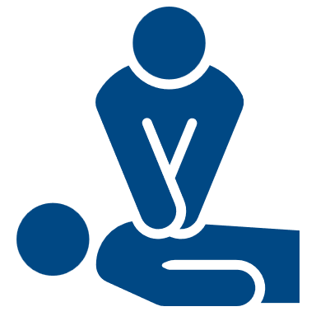

Input Action: Emergency Prep
The Council's Responses:
  Directly distributed PPE and disaster resources
  Delivered training to first and second responders
Provided emergency and disaster trainings for families and advocates
Notes:
In response SCDD developed multiple initiatives.
We provided training for first and secondary responders to improve their understanding of people with I/DD and to strengthen safe, respectful interactions.
We also trained self-advocates and families on practical steps like using personal protective equipment and assembling emergency go bags.
Beyond that, we helped communities learn how to navigate public safety advisories about disasters and shelters, ensuring that critical information was accessible and actionable for people with I/DD.

Slide 20
How Action Leads to Impact

Slide 21
2022-2026 State Plan Impacts
Employment
  More people with IDD are engaged in Competitive Integrated Employment
Self Advocacy
  SALA grads are shaping policy & leading locally
  Families are empowered to advocate and mentor
Emergency Preparedness
  Law enforcement recruits are now trained for empathy & respect
Notes:
Our impact is measured not only in numbers, but in the lives changed through our work.
Graduates of the Self-Advocacy Leadership Academy are now influencing policy and leading their communities, showing how investment in leadership development pays off.
One grandmother, who trained with SCDD, successfully advocated for her grandson’s education and has gone on to mentor other families — multiplying the impact of what she learned.
Through our law enforcement training, new recruits now approach calls involving individuals with disabilities with greater understanding, empathy, and respect — creating safer outcomes in their communities.
On a broader scale, we protected 5.8 million students from harmful restraint and seclusion practices through policy change, advancing dignity and safety in schools.
Together, these examples show how community input transforms not just systems, but lives — and why continued participation in shaping the State Plan is so critical.

Slide 22
The State Plan Process
Community Shares Input
Council Takes Action
Actions Lead to Outcomes
Impact Felt by Community
Notes:
As we wrap up, I want to step back and remind us of the bigger picture. Everything we’ve just reviewed — the outcomes and impacts — started the same way: with the communities ideas of how our systems can work better for us
The process is simple but powerful:
The community shares input about their needs and priorities.
The Council takes action, building programs, resources, and advocacy.
Those actions lead to measurable outcomes, like trainings delivered, partnerships built, or laws changed.
And ultimately, that results in real impact, felt in the lives of people with I/DD, their families, and communities across California.
This process doesn’t work without you. Your feedback is the foundation for everything we do.
That’s why the next State Plan survey is so important. By completing it, you’re taking the very first step in this cycle — providing the input that will drive SCDD’s work for the next five years.
Now, let’s look at how you can complete the survey and share it with others to make sure everyone is heard.

Slide 23
Dream the future forward...
Notes:
Before we go about completing it though, I want everyone to take a moment and close their eyes. Everything we spoke about today was what the community felt was important in 2020. Times have changed and I want you to focus on what your dreams of how systems could serve the IDD community better. Lets Dream the future forward. Think about what you'd like to change and be better. Or things you like and want more of. Hold those ideas in your mind. And lets bring them forward together right now.

Slide 24
Start the Survey!
https://scdd.ca.gov/stateplandevelopment/
Notes:
Can offer that there are computers here that folks can use

Slide 25
How to Get in Touch

Slide 26
How to Get in Touch
Join our Mailing List:
  https://scdd.ca.gov/contactus/
For Survey Support:
  (916) 263-7919
  Stateplan@scdd.ca.gov

